Slide 1





Moneyball in the Midwest: Analyzing Salary Efficiency in the AL Central
By: Maggie Murphy

Slide 2
AL Central 2024 Standings
1. Cleveland Guardians (92-69)
2. Kansas City Royals (86-76)
3. Detroit Tigers (86-76)
4. Minnesota Twins (82-80)
5. Chicago White Sox (41-121)
Notes:
Cleveland came out on top and made it to the ALCS where they were defeated by the Yankees
Kansas City made the playoffs and were eliminated in the ALDS
Detroit made the playoffs and were eliminated in the ALDS by the Guardians
The Twins and the White Sox both missed the playoffs

Slide 3
Payroll Disparities across the AL Central
Notes:
Chicago White Sox (CWS) have the highest payroll at approximately $140.5 million, despite having the worst record in the division (41-121). This represents a striking inefficiency in spending

Slide 4
Salary Efficiency across the AL Central

Slide 5
AL Central: Position Player Salary Efficiency Analysis (2024)

Slide 6
AL Central: Pitcher Salary Efficiency Analysis (2024)

Slide 7
AL Central: Pitcher Salary Efficiency Analysis (2024)

Slide 8
Chicago White Sox (41-121)
Top 3 Position Players based on $/WAR
Luis Robert Jr. - $8,928,571
Andrew Vaughn - $29,250,000
Nicky Lopez - $21,500,000
Bottom 3 Position Players based on $/WAR
Zach DeLoach - -$1,630,980
Bryan Ramos - -$1,034,280
Andrew Benintendi - -$21,375,000

Slide 9
Chicago White Sox (41-121)
Top 3 Pitchers based on $/WAR
Drew Thorpe - $4,375,800
Michael Soroka - $4,285,714
Fraser Ellard - $1,213,290
Bottom 3 Pitchers based on $/WAR
Mike Clevinger - -$30,000,000
Dominic Leone - -$2,142,857
Steven Wilson - -$1,178,917

Slide 10
Cleveland Guardians (92-69)
Top 3 Position Players based on $/WAR
Josh Naylor - $4,333,333
José Ramírez - $2,500,000
Andrés Giménez - $1,405,357
Bottom 3 Position Players based on $/WAR
Steven Kwan - $189,400
José Tena - -$1,030,620
Will Brennan - -$3,884,850

Slide 11
Cleveland Guardians (92-69)
Top 3 Pitchers based on $/WAR
Pedro Avila - $1,097,160
Eli Morgan - $569,132
Cade Smith - $540,703
Bottom 3 Pitchers based on $/WAR
Gavin Williams - -$7,421,000
Joey Cantillo - -$1,193,400
Xzavion Curry - -$802,977

Slide 12
Detroit Tigers (86-76)
Top 3 Position Players based on $/WAR
Colt Keith - $2,575,757
Jake Rogers - $1,700,000
Spencer Torkelson - $1,523,290
Bottom 3 Position Players based on $/WAR
Javier Báez* - -$22,727,273
Dillon Dingler - -$808,860
Justyn-Henry Malloy - -$765,765

Slide 13
Detroit Tigers (86-76)
Top 3 Pitchers based on $/WAR
Casey Mize - $4,150,000
Keider Montero - $3,580,200
Alex Faedo - $1,244,333
Bottom 3 Pitchers based on $/WAR
Kenta Maeda - -$7,777,778
Ty Madden - -$1,352,520
Mason Englert - -$464,100

Slide 14
Kansas City Royals (86-76)
Top 3 Position Players based on $/WAR
Salvador Perez - $8,000,000
Dairon Blanco - $7,437,500
Paul DeJong - $1,020,771
Bottom 3 Position Players based on $/WAR
MJ Melendez - -$838,611
Bobby Witt Jr. - $330,969
Kyle Isbel- $421,250

Slide 15
Kansas City Royals (86-76)
Top 3 Pitchers based on $/WAR
Michael Wacha - $4,838,235
Kris Bubic - $2,937,500
Seth Lugo - $2,777,778
Bottom 3 Pitchers based on $/WAR
Will Smith - -$6,250,000
Chris Stratton - -$5,000,000
Hunter Harvey - -$4,812,500

Slide 16

Minnesota Twins (82-80)
Top 3 Position Players based on $/WAR
Max Kepler - $10,000,000.00
Carlos Correa - $9,009,008.92
Carlos Santana - $2,200,000.00
Bottom 3 Position Players based on $/WAR
Manuel Margot - -$4,444,444.44
Edouard Julien - -$2,409,000.00
Austin Martin - -$560,898.00

Slide 17
Minnesota Twins (82-80)
Top 3 Pitchers based on $/WAR
Brent Headrick - $12,500,000
Diego Castillo - $11,250,000
Michael Tonkin - $4,500,000
Bottom 3 Pitchers based on $/WAR
Louis Varland - -$133,547
Scott Blewett - $223,763
Bailey Ober - $375,829

Slide 18
Top 10 AL Central Position Players based on $/WAR
Andrew Vaughn (CWS)
Nicky Lopez (CWS)
Max Kepler (MIN)
Carlos Correa (MIN)
Luis Robert Jr. (CWS)
Salvador Perez (KC)
Korey Lee (CWS)
Dairon Blanco (KC)
Josh Naylor (CLE)
Colt Keith (DET)

Slide 19
Top 10 AL Central Pitchers based on $/WAR
Brent Headrick (MIN)
Diego Castillo (MIN)
Michael Wacha (KC)
Michael Tonkin (MIN)
Drew Thrope (CWS)
Michael Soroka (CWS)
Casey Mize (DET)
Jhoan Durán (MIN)
Keider Montero (DET)
Kris Bubic (KC)
Notes:
** No CLE players on the list

Slide 20
Optimization Model Method/Steps

Slide 21
Budget Optimization Model for AL Central
Input Data Collection
Team salary data from 2024 season - based on what was on Spotrac.com (limited)
Performance data (WAR) for pitchers and position players
Current budget allocations for AL Central teams
Efficiency Calculation
Calculated $/WAR efficiency metrics for pitchers and position players
Optimization Model Design
Created budget allocation model with constraints
Used Excel Solver to find the optimal budget split that maximizes WAR

Slide 22
Budget Optimization Model for AL Central
Constraint Handling
Ensured both pitching and position player needs were met
Prevented solutions that would over allocate to one group
Accounted for negative position player WAR (White Sox)
Comparative Analysis
Compared current vs. optimal allocations for each team
Calculated potential WAR improvement and percentage gains
Identified teams with greatest optimization opportunities

Slide 23
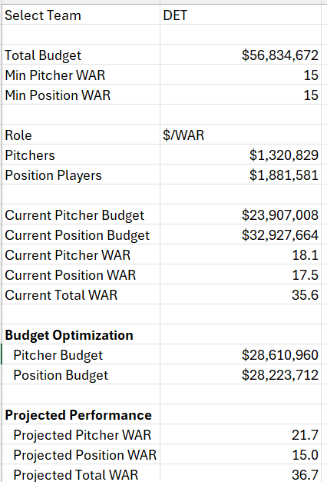
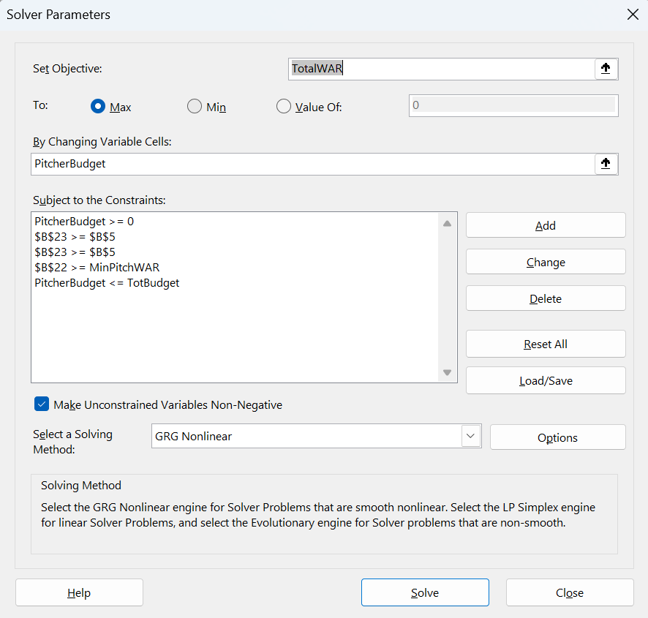
Optimization Sheet in Excel (images)

Slide 24
Optimization Model Findings

Slide 25
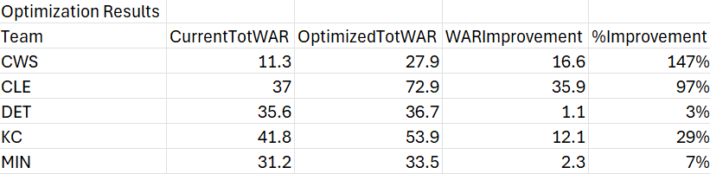
Optimization Results to be Transformed into Charts

Slide 26
Optimization Model Findings

Slide 27
Optimization Model Findings

Slide 28
Summary
Cleveland is the Moneyball team of the AL Central, spending is low, and performance is high
Detroit also keeps spending low and focuses on young talent as they continue to build
Kansas City and Minnesota spend around the same and finish middle of the pack
Chicago is spending too much for the lack of performance, creating inefficient spending

Slide 29
Disclaimer!!
All of these findings are based on the player salary data that was found on Spotrac.com
Many of the players did not have salary data so some of these findings could be skewed

